Slide 1
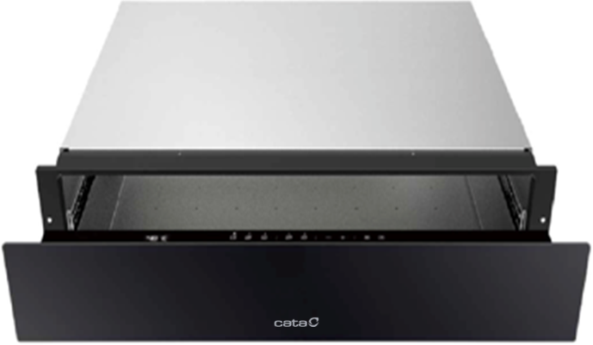







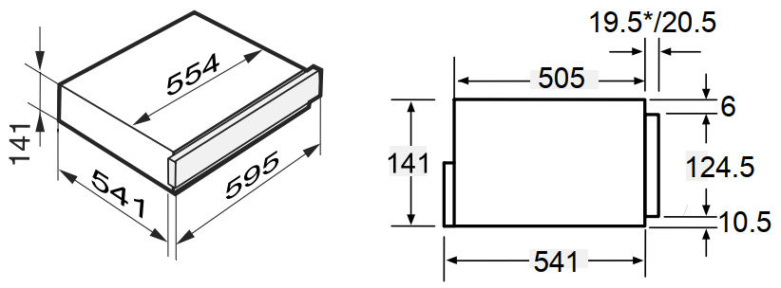
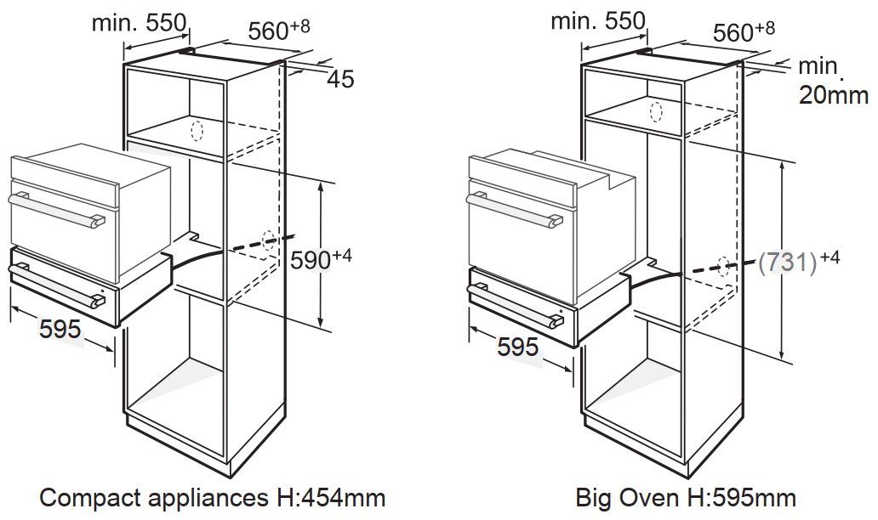
CAT14WDBK
14CM BUILT-IN WARMING DRAWER
Main Features
Brand | Cata
Product Category | Warming Drawer
Heat Source | Electric
Colour / Finish | Black
No. of Place Settings | 6
Capacity (net) | 22L
No. of Functions | 3
User Controls | Touch with LED Display
Suitable For | Defrosting, Proving Dough, Slow Cooking, Making Yoghurt, Melting Chocolate, Drying Food, Sterilising
Characteristics
Interior Finish | Stainless Steel
Max Load | 25kg
No. of Temperature Levels | 9
Adjustable Temperature Range | 40°C to 80°C
Warming Functions | Cups & Glasses Plates & Dishes Keep Food Warm
Drawer Opening | Push to Open
Drawer Mechanism | Telescopic Slide Rails
Soft Close | -
Drawer Colour | Black Glass
Drawer Handle | n/a
Control Panel | Black
Display Colour | White
Timer | 6 Hour
Internal Lights | -
Anti-Slip Mat | Yes
EAN
8422248617864
Technical Data
Rated Voltage | 220-240V ~ 50/60Hz
Max Power | 1000W
Supply Connection | 5A
Cable / Plug | 1.5m / -
Energy Efficiency Class | n/a
Dimensions & Weights
Product (WxHxD) | 595 x 141 x 561 mm
Built-In Niche (WxHxD) | 560 x 145 x 550 mm Below 45cm Compact: 560 x 590 x 550 mm Below 60cm Single Oven: 560 x 731 x 550 mm
Packed Product (WxHxD) | 705 x 210 x 640 mm
Net Weight | 18.0 kg
Gross Weight | 21.0 kg

